Slide 1
Tobacco Dependence

Slide 2
Link Between Secondhand Smoke and Growth in CF Patients by: Pulmonary Medicine and Infectious Diseases at Nationwide Children’s Hospital
Notes:
Columbus, OH

Slide 3
Studied infants with cystic fibrosis between 2008-2012
Of 75 infants in the study, 44 percent had at least one parent who smoked in the home.
Examined growth, lung function, chest CT scans and the incidence of bacterial infection at age 4 months and 1 year, then compared the data between infants exposed to secondhand smoke and those who weren’t
Notes:
They reviewed medical records of infants with cystic fibrosis who were seen in the Newborn Cystic Fibrosis Clinic at Nationwide Children’s between 2008 and 2012.
Researchers examined growth, lung function, chest CT scans and the incidence of bacterial infection at age 4 months and 1 year, then compared the data between infants exposed to secondhand smoke and those who weren’t

Slide 4
Infants in smoke-free homes grew about 50 percent more during their first year than infants whose parents smoked.
While no CF patients in non-smoking homes tested positive for MRSA during their first year, as many as 30 percent of infants exposed to secondhand smoke tested positive for the pathogen.

Slide 5
Coming up with a Quit Plan for those who smoke…

Slide 6
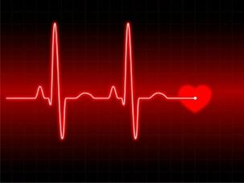
Step One
Half of all smokers die prematurely from smoking related disease by an average of 14 years.
What would you be able to do with those extra 14 years?
What are the benefits of quitting?

Slide 7
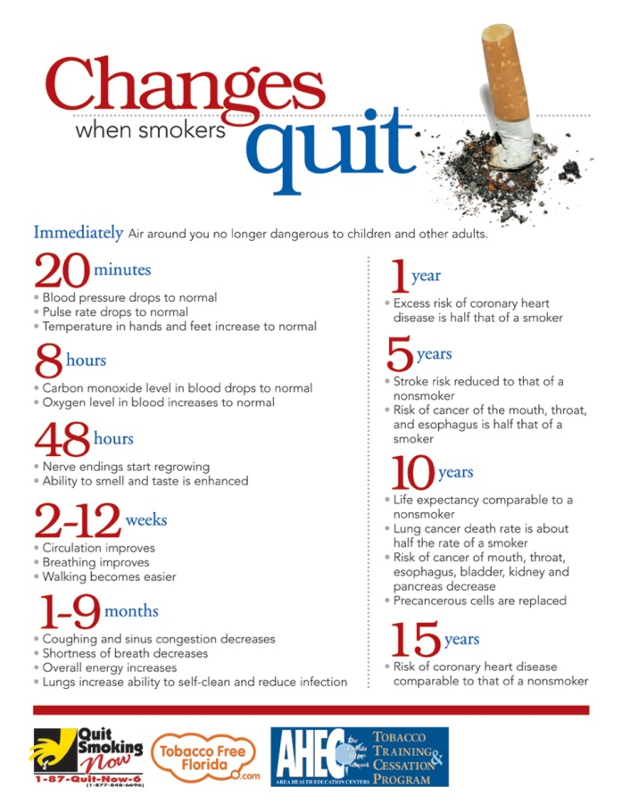

Slide 8
Step Two
Reasons to quit
Save money
Improve health
Whiter teeth
Improve physical performance
Reduce complications from illness
Healthier baby
Set an example for friends, family, and children
Get better health insurance
Clothes and breath smell better
Much less chance of lung and oral cancer

Slide 9
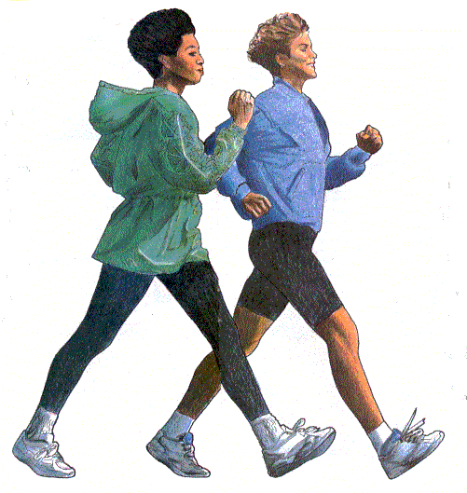
Step Three
Enjoying life without nicotine
What are some healthy activities that might also make you feel relaxed, focused, calm and steady?
Reading
Listening to music
Playing with kids
Exercising

Slide 10
Step Four
Why do people smoke?
Stimulation
Handling
Pleasure
Relaxation
Craving
Habit

Slide 11
Next to the following statements, mark the number that best describes your own experience. (5=Always, 4=Most of the time, 3=Once in a while, 2=Rarely, 1=Never)
___ A. I smoke to keep myself from slowing down. ___ B. Handling a cigarette is part of the enjoyment of smoking it. ___ C. Smoking is pleasant and relaxing. ___ D. I light up a cigarette when I feel angry about something. ___ E. When I am out of cigarettes, it's near-torture until I can get more. ___ F. I smoke automatically, without even being aware of it. ___ G. I smoke when people around me are smoking. ___ H. I smoke to perk myself up. ___ I. Part of my enjoyment from smoking is preparing to light up. ___ J. I get pleasure from smoking. ___ K. When I feel uncomfortable or upset, I light up a cigarette. ___ L. When I'm not smoking a cigarette, I'm very much aware of the fact. ___ M. I often light up a cigarette when one is still burning in the ashtray. ___ N. I smoke cigarettes with friends when I am having a good time. ___ O. When I smoke, part of the enjoyment is watching the smoke as I exhale. ___ P. I want a cigarette most often when I am comfortable and relaxed. ___ Q. I smoke when I am "blue" and want to take my mind off what's bothering me. ___ R. I get a real hunger for a cigarette when I haven't had one in a while. ___ S. I've found a cigarette in my mouth and haven't remembered it was there. ___ T. I always smoke when I am out with friends at a party, bar, etc. ___ U. I always smoke cigarettes to get a lift.

Slide 12
Step Four Cont.
Tips to help with:
Stimulation: Get enough rest, take a brisk walk instead of smoking when feeling sluggish, eat regular, avoid getting bored.
Handling: pick up a pen when you want to reach for a cigarette, take up a hobby that keeps hands busy, have a snack such as carrot sticks, apple slices, bread sticks.
Pleasure: Spend the money you save on cigarettes on another kind of pleasure, remind yourself of the health benefits of quitting.

Slide 13
Step 4 Cont.
Tips to help with:
Relaxation: Use relaxation techniques, exercise regularly, get enough rest.
Craving: Nicotine replacement therapy (NRT), Keep away from cigarettes, get rid of ashtrays, destroy any cigarettes you still have, ask family and friends to help.
Habit: Change smoking routine before quit day by keeping cigarettes in different place, smoke with opposite hand, when you want a cigarette wait one minute and try to think of something else instead, set a date!

Slide 14
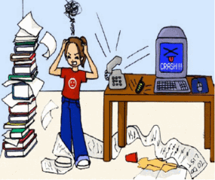
Step Five
Prepare for Triggers
Identify all the times you use tobacco:
When I’m tired
When I’m Hungry
When I’m Stressed

Slide 15
Step Six
Come up with ideas of what you could do instead of smoking when:
Waking up
Bored
Driving
After meals
Drinking
On the phone
Stressed

Slide 16
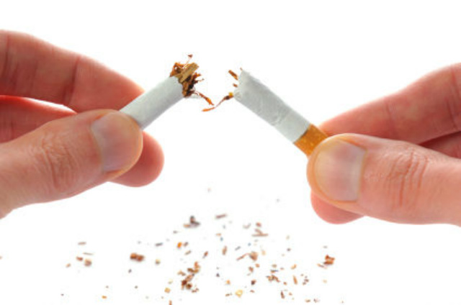
Step Seven
Select your quit day!
My “Quit Day” is .
I WILL NOT USE TOBACCO ON THIS DAY OR ANY DAY AFTER THAT!

Slide 17
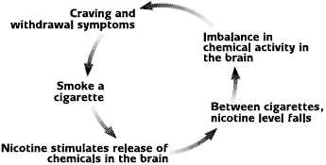
Nicotine Effect on the Brain

Slide 18
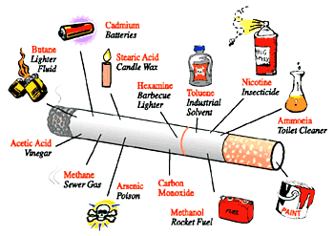
What’s in a cigarette

Slide 19
Weight Gain: What you need to know
Tobacco does NOT make you thin and quitting WILL NOT make you fat!
There may be a slight change in metabolism when you quit
Exercise can help keep metabolism from slowing
You may feel hungry more often then when you used tobacco
Food is going to smell better and taste better!
You might want to eat to keep from using tobacco.

Slide 20
Dealing with Stress
Make a list of things, situations, or people that stress you out and think of ways to deal with it other than smoking.

Slide 21
Physical Stress Reducers
Stretch, practice deep breathing, close eyes and think pleasant thoughts, hot bath.
Eat well and consume healthy foods
Get plenty of rest.
Set time aside for yourself to enjoy.

Slide 22
Mental Stress Reducers
Take a break; let your mind relax
Get organized
Be good to yourself
Talk to relatives, friends, or clergy about anxieties.
Learn to ask for what you need

Slide 23
The 4 D’s
Delay
Do something else to distract yourself
Drink a lot of water and other fluids
Deep breathe
Notes:
Drink lost of water to flush out the nicotine
Delay – having that cig

Slide 24
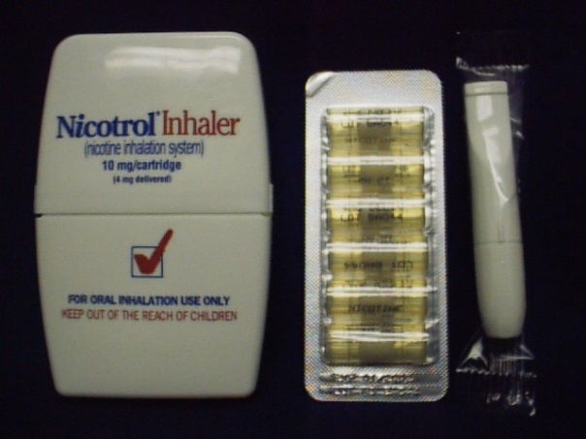
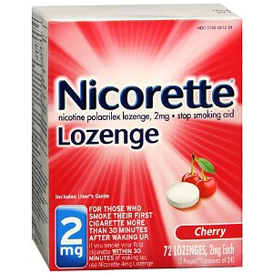
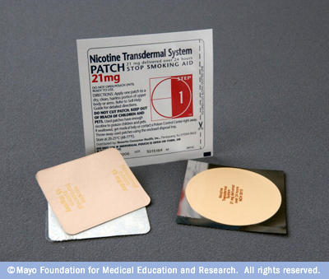
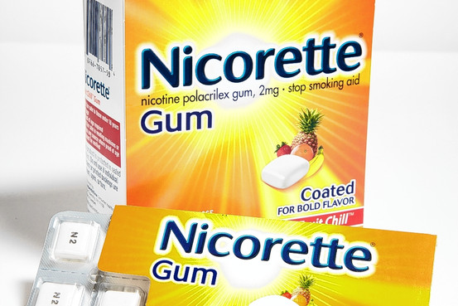
Nicotine Replacement Therapy

Slide 25
Face to face counseling with Tools to Quit or Quit Smoking Now classes.
Talk to a quit coach
1-877-822-6669
Online Program
http://www.ahectobacco.com

